Slide 1


Slide 2
VCS – version control system
Enable teams to collaborate on projects together
Enable to review project history

Slide 3
VCS – version control system
Which changes were made?
Who made the changes?
When were the changes made?
Why were changes needed?

Slide 4
Distributed VCS
Complete codebase, including its full history, is mirrored on every developer's computer
Allows every user access to a full and self-contained history of all changes
Don’t need a constant connection to a central repository

Slide 5
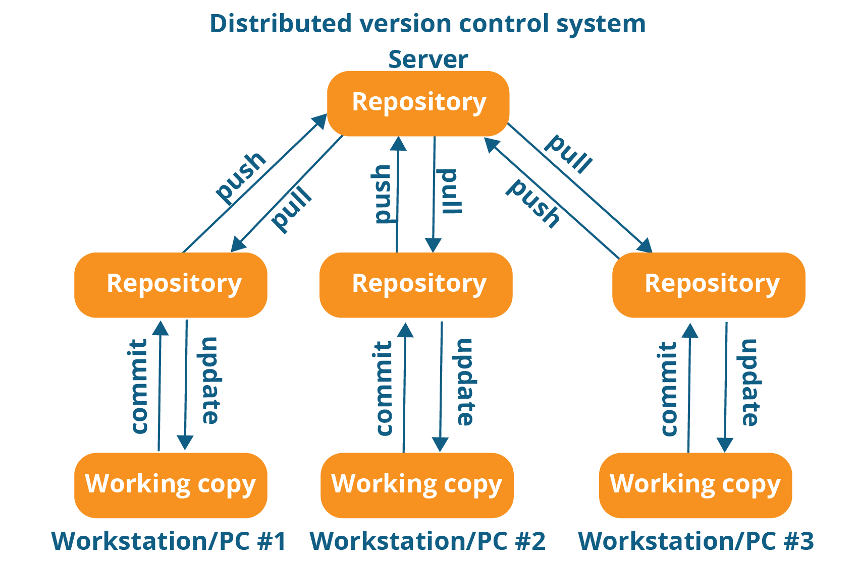

Slide 6
Git repository
Git repository is a collection of files and folders associated with a project, along with each file’s revision history
Commits are snapshots of files at specific moment of time

Slide 7
Commits & branches
Commits are linked to each and form lines of development called branches:

